Slide 1
MBJ Dashboard
File created on: 7/16/2022 3:15:03 AM

Slide 2
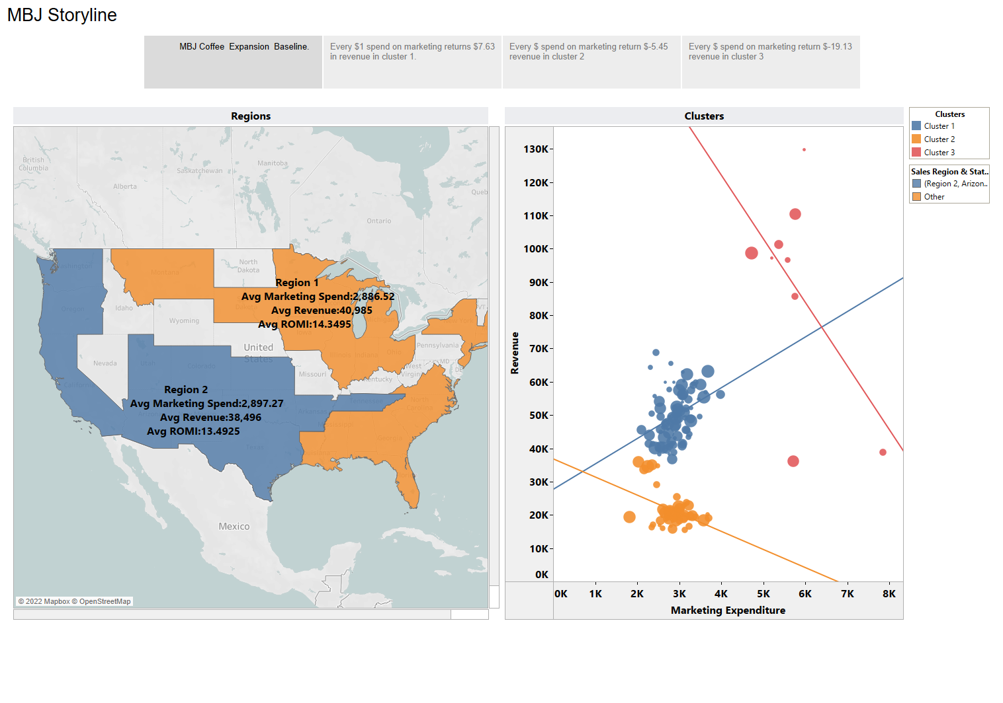

Slide 3
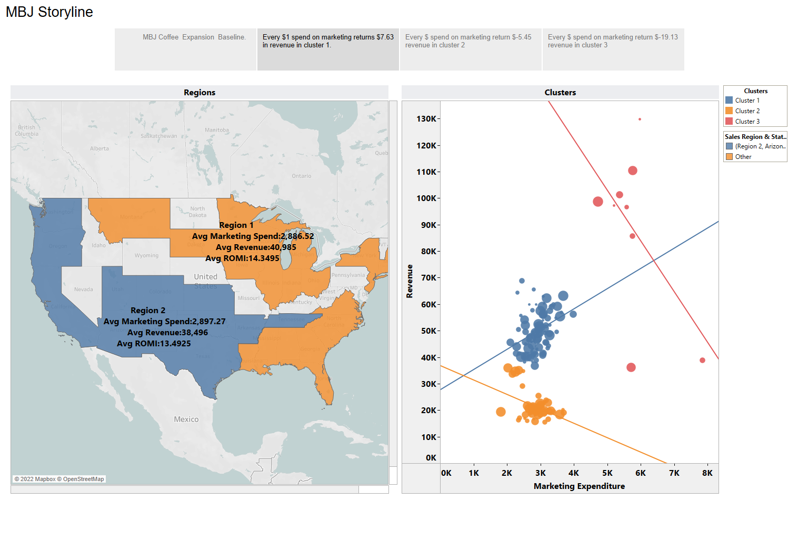

Slide 4
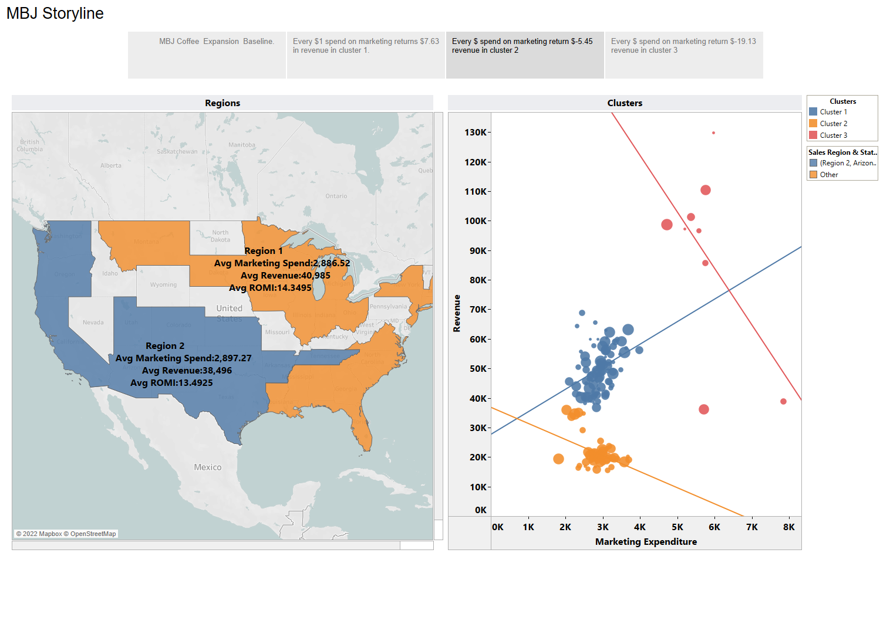

Slide 5
